Slide 1
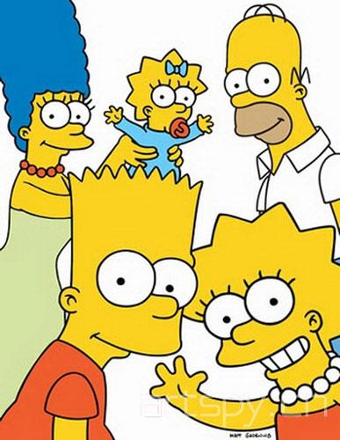
Image Detection of Simpson’s Characters
George Mason University
DAEN 690
Summer 2019

Slide 2


Roles of Team members
Team Roles:
Product Owner – Ravi Rane
Scrum Master – Manju Prasad
Developer – Yinchen Niu
Developer – Zegang Liu

Slide 3

Introduction
Object detection and image classification are at the forefront of computer vision technologies found throughout society today. Recent advancements in facial-detection-based surveillance in the security industry, pedestrian and sign detection in self-driving cars, and automated valuation of properties are all applications of this cutting-edge technology.
We want to:
Classify Simpson characters from images and from videos
Extend this functionality when we have multiple characters in an image.
Be able to recognize each individual character and draw bounding box around each
Have good interface to perform the classification

Slide 4
Project Description
Utilizing the popular 30-season show The Simpsons, this project implements object detection and image classification for primary characters from the Simpsons series.
Various deep learning architectures:
Convolutional Neural Network (CNN)
Faster Region-based Convolutional Neural Network (R-CNN)
You Only Look Once (YOLO)
Single Shot Multi-box Detection (SSD)

Slide 5
Project Description
As a secondary focus, this project implements YOLO to videos and explores the use of cloud computing to train and execute models. Visualizations and a User Interface (UI) that enable a real-time data feed to model execution are also implemented to encourage further use of our findings.

Slide 6
Why We Chose This Project?
We want to classify Simpson characters from images and from videos. We also want to extend this functionality when we have multiple characters in an image. We should be able to recognize each individual character and draw bounding box around each. We need to have good interface to perform the classification.
Simpson is a very popular cartoon and our team was interested in working on an image analytics related project. On seeing the Kaggle dataset related to image detection of Simpson’s characters (as proposed in the Suggested Projects by our Professor), our team decided to work on this.

Slide 7
Agile – Project plan & Sprint breakdown
Add YouTrack Report - Manju

Slide 8

About Data
License CC BY-NC-SA 4.0 (Creative Commons License)
(Who)
Agent
Data set was downloaded from Kaggle.com
(How)
Dataset has grown since it was initiated because author has added new images over a period of time.
(What)
Interest in image analytics, deep learning.
(Why)
Cause
Reason
Location
Time
In Kaggle.com
(Where)
Simson’s seasons 4-24
(When)

Slide 9
About Data
The image dataset available on Kaggle.com has 20 folders (one for each Simpson character) with 400-2000 pictures in each folder.
This image dataset is a collection of video frame captures from Simpson’s episodes. Dataset includes images that feature multiple characters in a single frame.
There may be insufficient images with multiple characters for tagging. This may require the team to generate additional frames with multiple characters.
File descriptions and explanations:
File simpson-set.tar.gz : This is an image dataset: 20 folders (one for each character) with 400-2000 pictures in each folder.
File annotation.txt : Annotation file for bounding boxes for each character

Slide 10
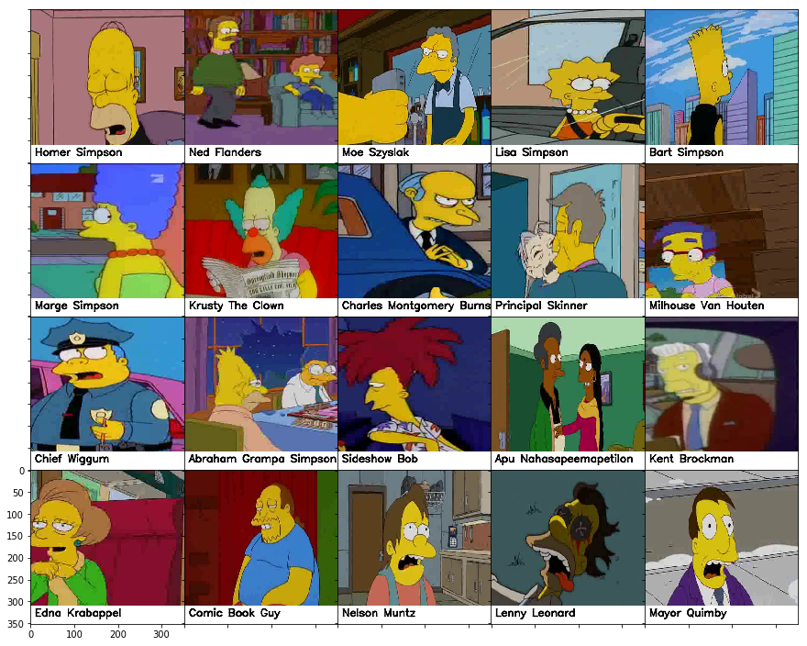
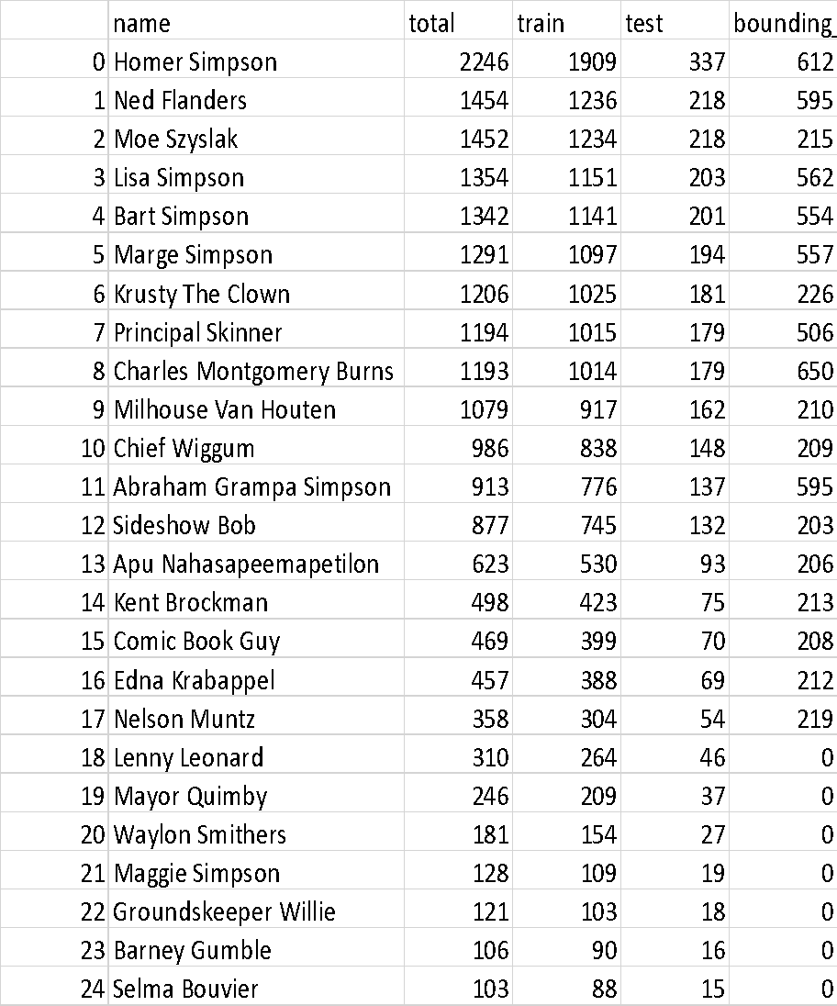
About Data
Table showing all characters with over 100 images in the dataset

Slide 11
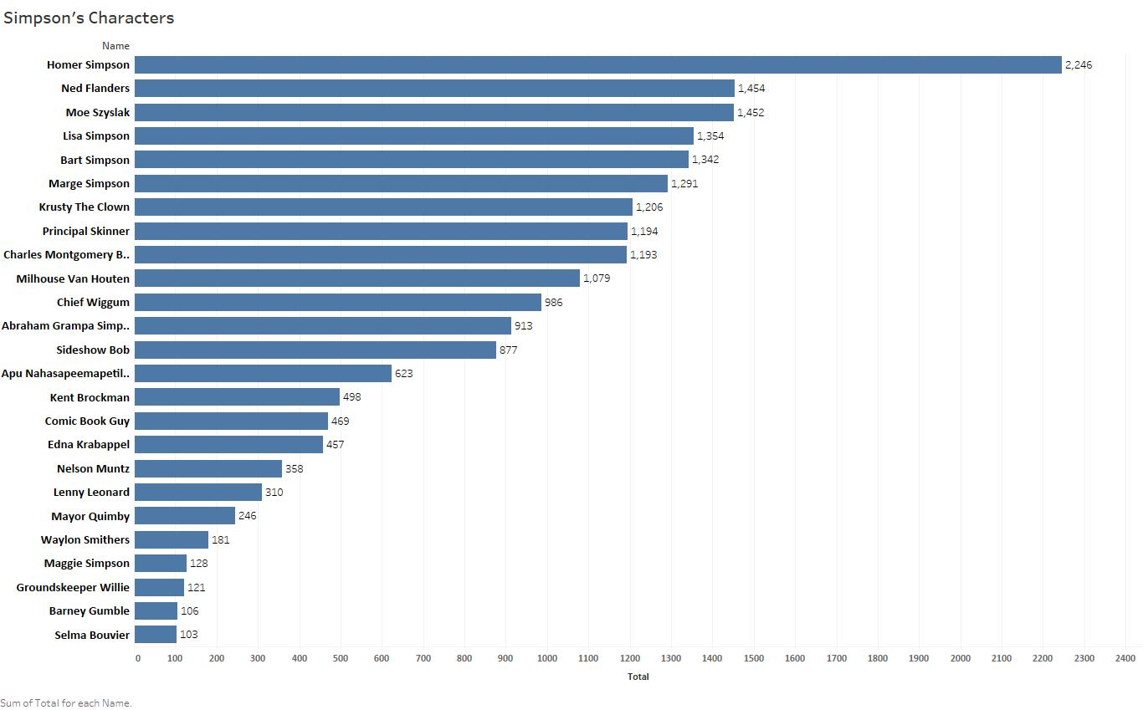
About Data

Slide 12
About Data
Data Quality Assessment
Completeness: (All available data is present)
Characters being classified are when subject image count is greater than 100.
Uniqueness: (No data duplication)
Image set consists of mixed images (as depicted in previous slides). Total count of images make it impossible to visually identify uniqueness.
Accuracy: (Data values stored for an object are the correct values)
Not determinable at this time. This can be determined after algorithms have been executed.
Atomicity: (Lowest level of detail)
Training set contains images that are classified and grouped by character.
Image level annotation to box characters is also provided.
Conformity: (conformity to the defined business requirements and syntax)
The dataset provided conforms to one required to run image classification models.
Overall Quality: Good

Slide 13

Core Goals & Stretch Goals

Slide 14
SafE Agile – Sprint breakdown

Slide 15
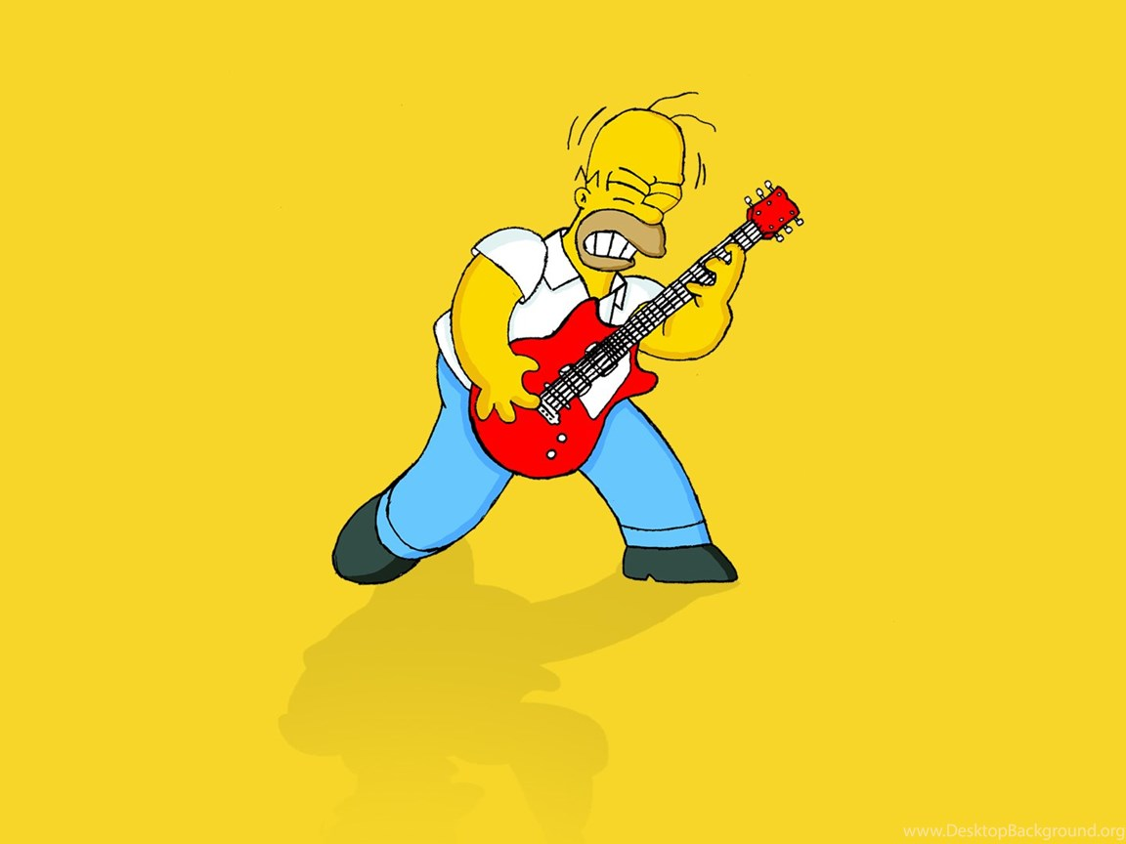
Agile – Project plan & Sprint breakdown
Add YouTrack Report - Manju

Slide 16

Core Goal 1 - CNN

Slide 17
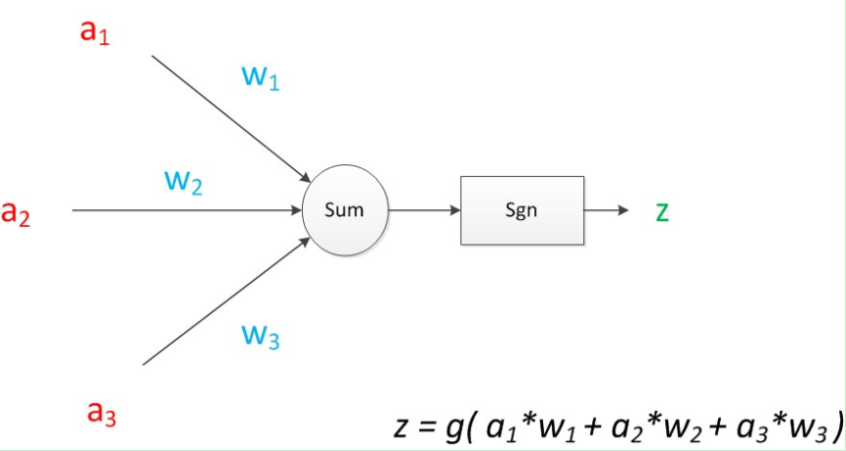
Convolutional Neural Network
A Convolutional Neural Network (CNN) is a multilayer perceptron specially designed for recognizing image contents.
It has three basic layers: Convolutional Layer, Pooling Layer, Flatten Layer & Fully Connected
The CNN sifts through the dataset and classifies each input image into a category. The computer then treats each input image as an array of pixels. According to the image resolution, we can see h * w * d (h = height, w = width, d = size) (Prabhu, 2018).

Slide 18
CNN (In Our Project）
CNN is the basic algorithm for our other algorithms and hence assumes a foundational role in this project. In this project, the CNN is the mastermind behind image classification.
For the deep learning CNN model, each image will go through a series of convolution layers, as well as kernel, pooling and full-connected layers (FC). We can add many convolutional layers and flatten the output into the FC Layer. At last, through an activation function, the results can be output to a class, and the images are classified.
This section had set up 4 convolution layers and we have tried 6 convolution layers.

Slide 19
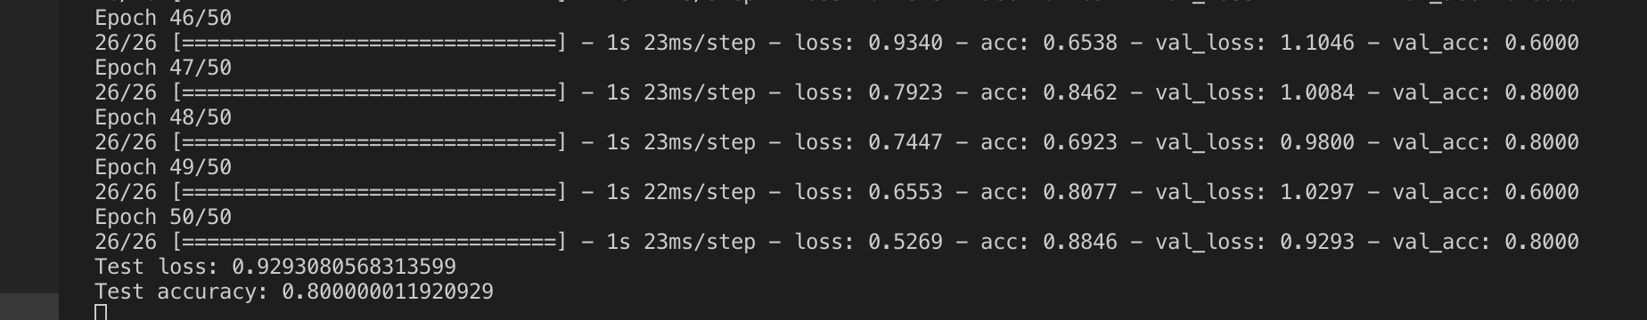
First Result
From ARGO(sample data):

Slide 20
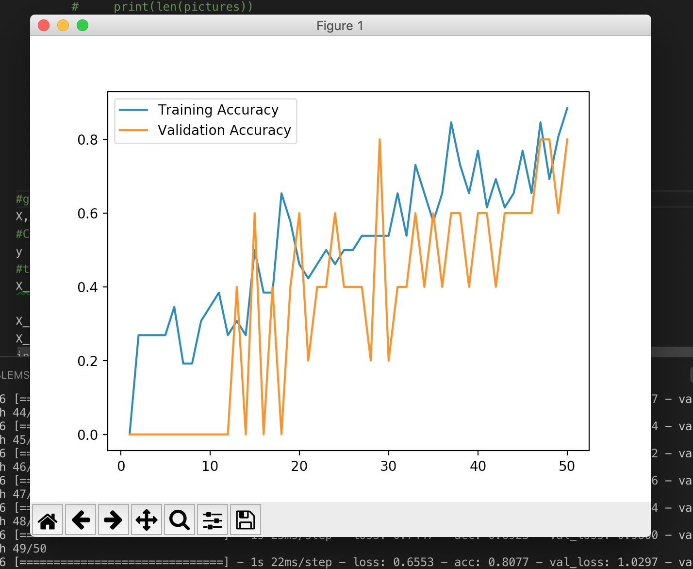
First Result

Slide 21
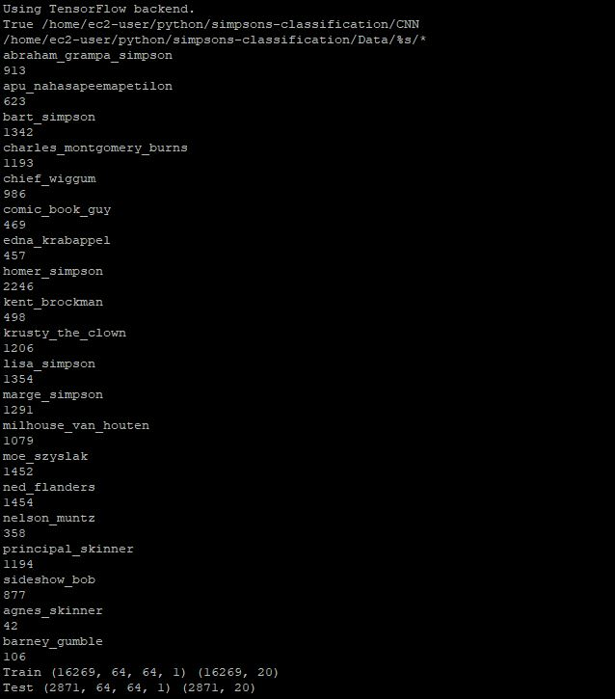
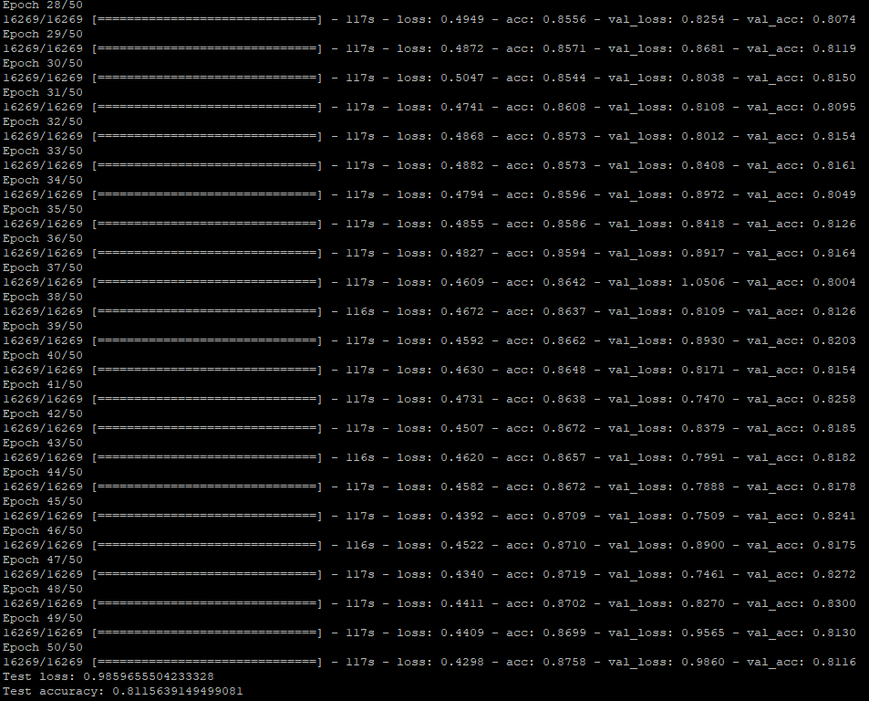
Result on AWS(EC2)

Slide 22
Core Goal 2 - FasterRCNN

Slide 23


Slide 24
Core Goal 3 - YOLO

Slide 25
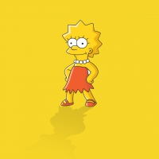
Core Goal 3 - YOLO
History and architecture
Used for classification, classification + localization, multiple objects (detection)
Runs fast and therefore can be used for realtime object detection.
Prior detection systems repurpose classifiers or localizers to perform detection. They apply the model to an image at multiple locations and scales. High scoring regions of the image are considered detections.
We use a totally different approach. We apply a single neural network to the full image. This network divides the image into regions and predicts bounding boxes and probabilities for each region. These bounding boxes are weighted by the predicted probabilities.
Our model has several advantages over classifier-based systems. It looks at the whole image at test time so its predictions are informed by global context in the image. It also makes predictions with a single network evaluation unlike systems like R-CNN which require thousands for a single image. This makes it extremely fast, more than 1000x faster than R-CNN and 100x faster than Fast R-CNN.
What's New in Version 3?
YOLOv3 uses a few tricks to improve training and increase performance, including: multi-scale predictions, a better backbone classifier. YOLOv3 uses multi-label classification. For example, the output labels may be “pedestrian” and “child” which are not non-exclusive. (the sum of output can be greater than 1 now.) YOLOv3 replaces the softmax function with independent logistic classifiers to calculate the likeliness of the input belongs to a specific label. Instead of using mean square error in calculating the classification loss, YOLOv3 uses binary cross-entropy loss for each label.
Darknet
Darknet is an open source neural network framework written in C and CUDA

Slide 26
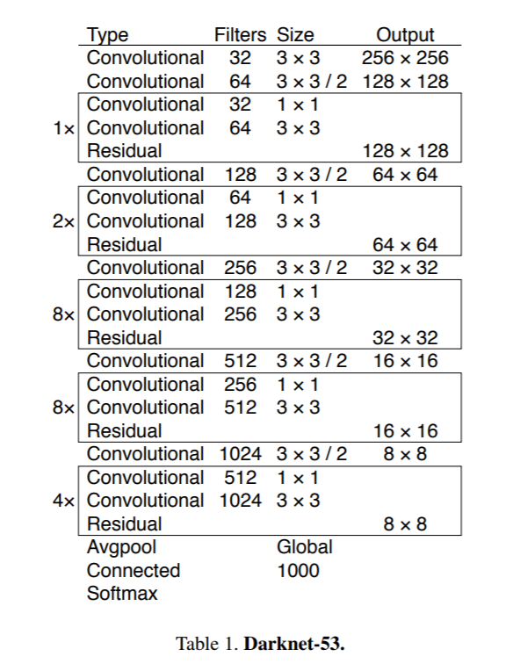
Core Goal 3 - YOLO
Architecture
Draw Grid and explain output grid
Evaluate object localization using iOu
Use non max suppression

Slide 27
Core Goal 3 - YOLO
Approach taken
Python
Pre-trained model – Momo image and video (include images and videos)
Limits on local machine, used ARGO
Used Darknet preexisting weights to train
Frozen layers to reduce spikes in loss , followed by unfrozen layer
Call back functions to change learning rate and stop training if gains are leveled out.
Multiple trainings – different hyperparameters (due to cluster limitations, improving results)

Slide 28
Core Goal 3 - YOLO
Results:
Tensor Board output
Comparison between models created
Model | Characteristics/ Hyperparameters | Time taken to train | Validation Loss | Detections on set of 8 images | Multi-Object detection | Incorrect detections | Detection on 2 videos
10+10nonfreeze_32_10batch
10+10nonfreeze_32_10batch_fullset
25Epochs, 64 Batch size, 3 Classes starting with 0
50Epochs, 64 Batch size, 3 Classes starting with 0
20190711-175339_929718_20E32B_50E_10B
20190711-194444_929750_20E32B_50E32B
20190714-15095750E_32B_ValSplit.2_Darknet
20190714-220626100E_32B_ValSplit.1_Darknet
20190717-22182815FE_100E_32B_ValSplit.1_Darknet
20190723-19191315FE_50E_10B_ValSplit.1_Darknet
20190724-23420315FE_50E_32B_ValSplit.2_Darknet
events.out.tfevents.1564118979.NODE081.orc.gmu

Slide 29
Core Goal 3 - YOLO
Results:
Sample images
Sample videos

Slide 30
Core Goal 3 - YOLO
Results:
Why the difference?
Insufficient images? w/ bounding boxes?
Quality of variance in character position in images?
Lisa vs Maggie
Additional Data augmentation methods – jitter, flip (one direction) included
Anchor box K means
Frames per second
Challenges faced?
Overall experience
Time taken averages
Experience with ARGO
OOO, H5 file issues,
Multi-GPU issues

Slide 31
Core Goal 4 - SSD

Slide 32
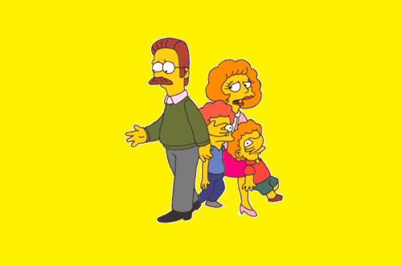
Stretch Goals #1

Slide 33
Stretch Goals #2

Slide 34

Stretch Goals #3

Slide 35
Stretch Goals #4 – Cloud Computing
Zegang & Yinchen
Focused on AWS compute services

Slide 36
Stretch Goals #4 – Cloud Computing
Focused on exploring AWS Managed Service – Sagemaker
Used Out of Box AWS prebuilt object detection algorithm to train model
On Homer Simpson
Uses Sagemaker Notebook, Sagemaker Training, Sagemaker Inference/Hosting
Next steps:
Train on all characters
Improve detection by modifying hyperparameters
Challenges:
Data prep
Service Quota increase for ML instances

Slide 37

With more time…

Slide 38
Challenges / Learnings

Slide 39
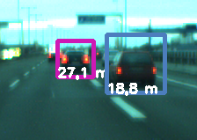
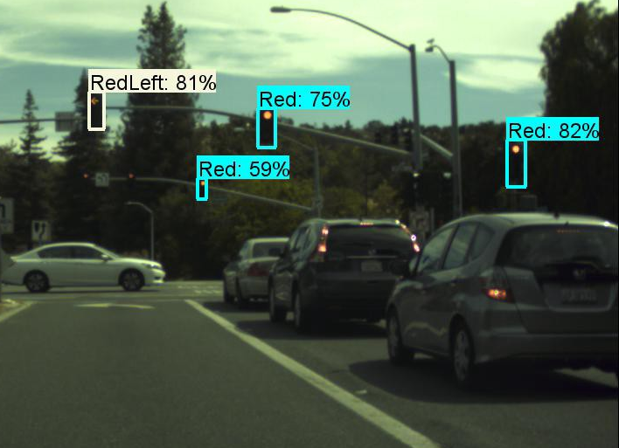
Concept Applications
Cars
Self-driving
Pedestrian detection
Digital Mapping
Google Maps/Waze recognizing street signs, speed limits…
Extension of Google Earth & Google Street View
Security
Facial Recognition Systems

Slide 40
Acknowledgements
Tad Berkery – Intern at GMU
Tad has helped this team in various ways: helping research TensorBoard, organize and enrich content in PowerPoint as well as the Final report. He has been an enthusiastic participant, always raising his hand to help the team out with various tasks.

Slide 41
References
alexattia. (2018). The Simpsons Character Dataset. Retrieved from Kaggle:
https://www.kaggle.com/alexattia/the-simpsons-characters-dataset
Brownlee, J. (2017, August 21). CNN Long Short-Term Memory Networks. Retrieved
from Machine Learning Mastery: https://machinelearningmastery.com/cnn-
long-short-term-memory-networks/
Chollet, F. (2016, June 5). Building powerful image classification models using very little data.
Retrieved from The Keras Blog: https://blog.keras.io/building-powerful-image-
classification-models-using-very-little-data.html
Crawford, C. (2016, November 4). An Introduction to Deep Learning. Retrieved from Algorithmia:
https://blog.algorithmia.com/introduction-to-deep-learning/

Slide 42
References
Duc, N. V. (2011, May 20). Object detection and distance calculation
based on stereo vision technique. Retrieved from YouTube:
https://www.youtube.com/watch?v=PR9tlFay0U8
Gandhi, R. (2018, May 18). Build Your Own Convolutional Neural Network in
5 mins. Retrieved from Towards Data Science:
https://towardsdatascience.com/build-your-own-convolution-neural-
network-in-5-mins-4217c2cf964f
Girshick, R. (2014, September 27). Fast R-CNN. (Cornell University) Retrieved from
arXiv.org: https://arxiv.org/abs/1504.08083
Kaiming He, G. G. (2018, January 24). Mask R-CNN. (Cornell University) Retrieved from arXiv.org:
https://arxiv.org/abs/1703.06870

Slide 43
References
Duc, N. V. (2011, May 20). Object detection and distance calculation
based on stereo vision technique. Retrieved from YouTube:
https://www.youtube.com/watch?v=PR9tlFay0U8
Gandhi, R. (2018, May 18). Build Your Own Convolutional Neural Network in
5 mins. Retrieved from Towards Data Science:
https://towardsdatascience.com/build-your-own-convolution-neural-
network-in-5-mins-4217c2cf964f
Girshick, R. (2014, September 27). Fast R-CNN. (Cornell University) Retrieved from
arXiv.org: https://arxiv.org/abs/1504.08083
Kaiming He, G. G. (2018, January 24). Mask R-CNN. (Cornell University) Retrieved from arXiv.org:
https://arxiv.org/abs/1703.06870

Slide 44
References
Kaiming He, X. Z. (2015, December 10). Deep Residual Learning for
Image Recognition. Retrieved from arXiv.org:
https://arxiv.org/abs/1512.03385
Madrigal, A. C. (2012, September 6). How Google Builds Its Maps—and
What It Means for the Future of Everything. Retrieved from The
Atlantic: https://www.theatlantic.com/technology/archive/2012
/09/how-google-builds-its-maps-and-what-it-means-for-the-
future-of-everything/261913/
qqwweee. (2018, April 2). keras-yolo3. Retrieved from GitHub:
https://github.com/qqwweee/keras-yolo3

Slide 45
References
Ross Girshick, J. D. (2014, October 22). Rich feature hierarchies for accurate
object detection and semantic segmentation. (Cornell University)
Retrieved from arXiv.org: https://arxiv.org/abs/1311.2524
Sarkis, A. (2017, September 19). Self-Driving Cars: Implementing Real-Time Traffic
Light Detection and Classification in 2017. Retrieved July 27, 2019, from
Medium: https://medium.com/@anthony_sarkis/self-driving-cars-implementing-
real-time-traffic-light-detection-and-classification-in-2017-7d9ae8df1c58
Shaoqing Ren, K. H. (2016, January 6). Faster R-CNN: Towards Real-Time Object Detection with
Region Proposal Networks. (Cornell University) Retrieved from arXiv.org:
https://arxiv.org/abs/1506.01497

Slide 46
References
Sharma, J. G. (2018, September 27). Deep CNN-ELM Hybrid Models for
Fire Detection in Images. doi:https://doi.org/10.1007/978-3-030-
01424-7_25
Shoji Kido, Y. H. (2019, May 31). Detection and classification of lung
abnormalities by use of convolutional neural network (CNN) and
regions with CNN features (R-CNN). (IEEE) Retrieved from IEEE Xplore
Digital Library: https://ieeexplore.ieee.org/document/8369798
Simplilearn. (2018, June 19). Convolutional Neural Network Tutorial (CNN) |
How CNN Works | Deep Learning Tutorial | Simplilearn. Retrieved
from YouTube: https://www.youtube.com/watch?v=Jy9-aGMB_TE

Slide 47
References
Skymind. (n.d.). A Beginner's Guide to Neural Networks and Deep
Learning. Retrieved from Skymind AI:
https://skymind.ai/wiki/neural-network#define
Stark, H. (2017, April 26). Since You Asked, Here's How Google Maps Really
Works. Retrieved from Forbes:
https://www.forbes.com/sites/haroldstark/2017/04/26/since-you-
asked-heres-how-google-maps-really-works/#56822cb34dbe
Suresh Prasad Kannojia, G. J. (2018, September 27). Ensemble of Hybrid CNN-
ELM Model for Image Classification. Retrieved from IEEE Xplore Digital
Library: https://ieeexplore.ieee.org/document/8474196/authors#authors

